Slide 1


OpenSim – Python
Hernandez Vincent

Slide 2
2
Content
First class: install all the program needed (OpenSim, Python ...)
Second class: use the Opensim Graphical User Interface (GUI) to launch a model, see the markers data, place virtual markers on the musculoskeletal model
Third class: Scale geometrically a musculoskeletal model with Python
Fourth class: Inverse Kinematics (IK) with Python
Fifth class: Inverse Dynamics (ID) with Python

Slide 3
3
Class 1

Slide 4

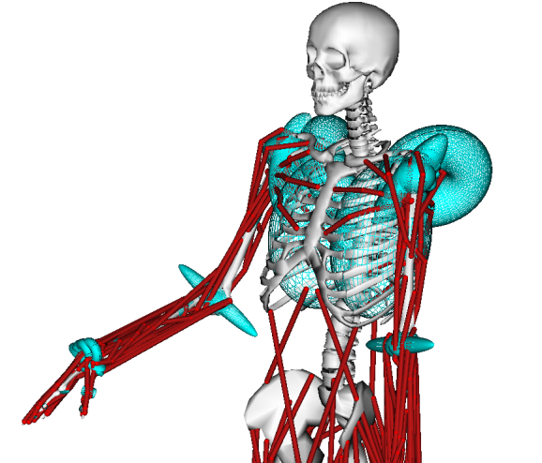
4
What is OpenSim ?
OpenSim is an open source software use for biomechanical modeling,
simulation and analysis:
you can create your own model or modify existing one
Inverse Kinematics
Inverse Dynamics
Analysis of joint
How much muscle forces is necessary (motion, external force)
More than 100 different musculoskeletal model are available.
More information about the OpenSim project:
http://opensim.stanford.edu/
Source code:
https://github.com/opensim-org/opensim-core

Slide 5
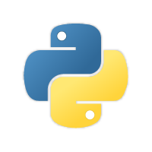
5
What is Python ?
Python is an easy to use programming language compare to C#, C++, JAVA …
Widely use in a lot of research field (Biomechanics, data science …)
A wide variety of library for different purpose:
Numpy: multi-dimensional arrays and matrices. Large collection of mathematical functions
Pandas: data structures, numeric tables and time-series data
Tensorflow and sklearn: machine learning library
Access to the OpenSim API to create and simulate models
Free to use compare to Matlab® which is expensive

Slide 6

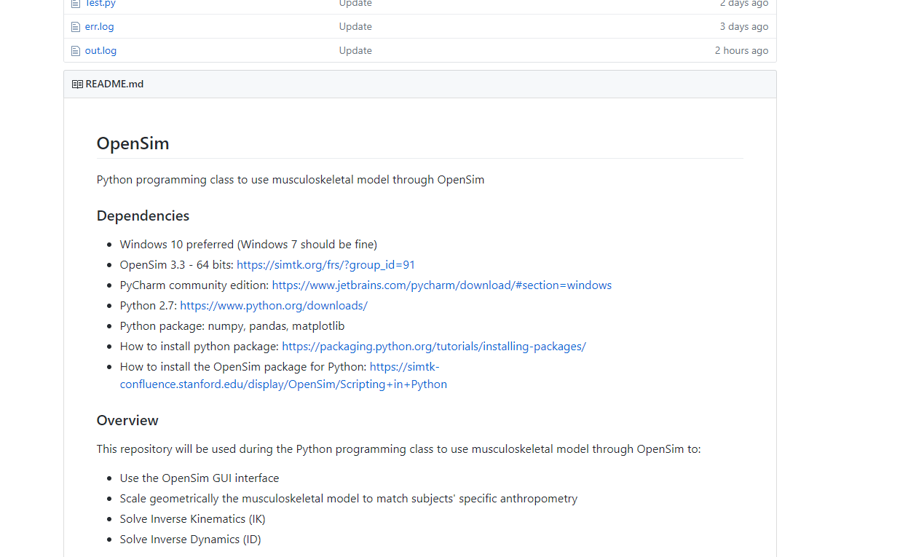
6
GitHub repository
GitHub repository:
https://github.com/GVLABHernandez/OpenSim

Slide 7
7
Install OpenSim 3.3
OpenSim:
https://simtk.org/frs/?group_id=91
Login: vh35
Password: opensim
OpenSim will be install at the root of your hard drive (C:\OpenSim 3.3)

Slide 8

8
Install Python 2.7 and PyCharm
Python 2.7.14:
https://www.python.org/downloads/release/python-2714/
Download this file: Windows x86-64 MSI installer
PyCharm community edition:
https://www.jetbrains.com/pycharm/download/#section=windows

Slide 9
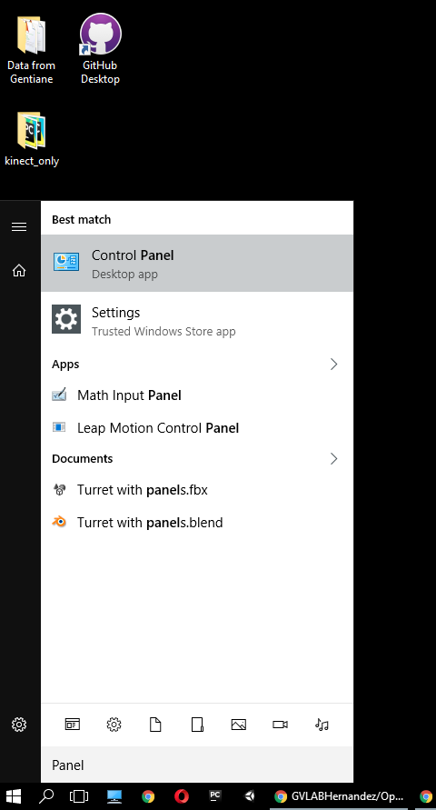
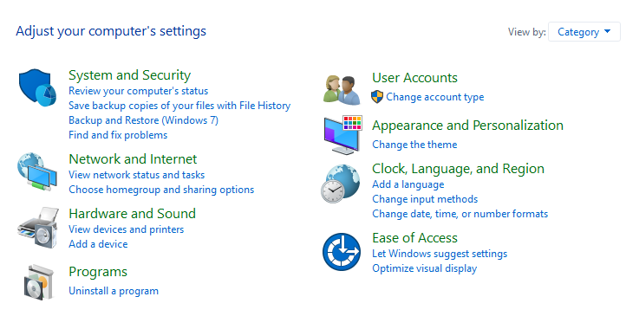
9
Insert OpenSim into the System Path
Control Panel -> System -> Advanced system settings -> Environment variables
Choose large icons

Slide 10
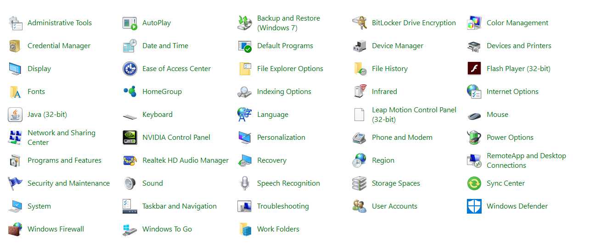
10
Insert OpenSim into the System Path
Control Panel -> System -> Advanced system settings -> Environment variables

Slide 11
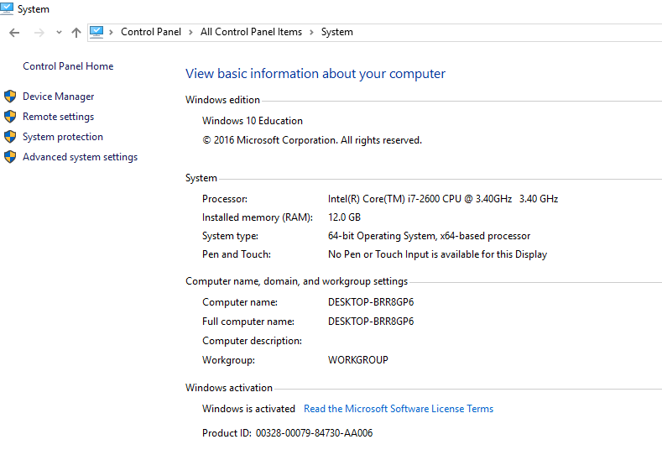
11
Insert OpenSim into the System Path
Control Panel -> System -> Advanced system settings -> Environment variables

Slide 12
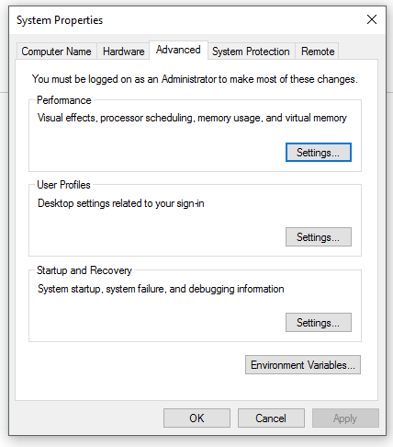
12
Insert OpenSim into the System Path
Control Panel -> System -> Advanced system settings -> Environment variables

Slide 13
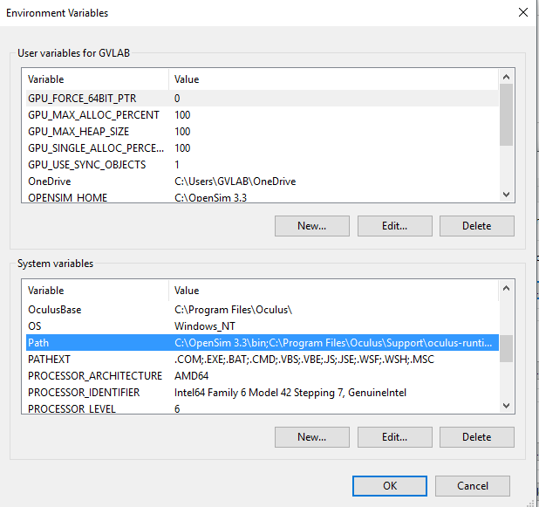
13
Insert OpenSim into the System Path
Control Panel -> System -> Advanced system settings -> Environment variables

Slide 14
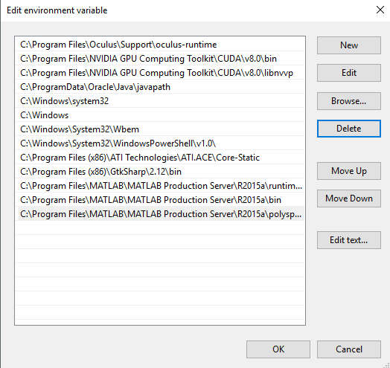
14
Insert OpenSim into the System Path
Control Panel -> System -> Advanced system settings -> Environment variables
C:\OpenSim 3.3\bin

Slide 15
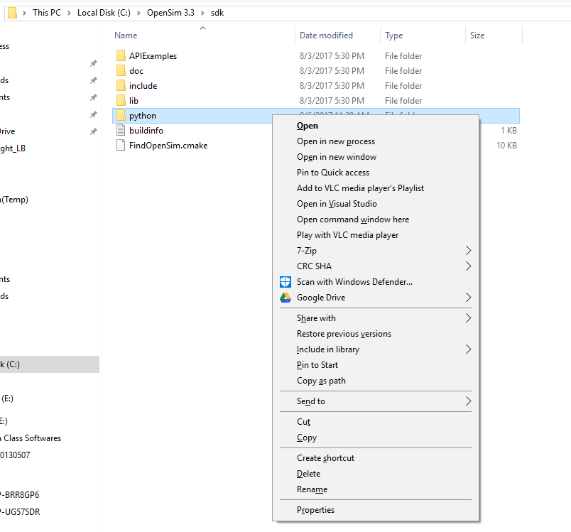

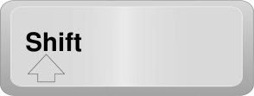
15
Run the OpenSim Setup File from Command Line
C:\OpenSim 3.3\sdk
+
Shift + Right-Click on the python folder
python setup.py install

Slide 16
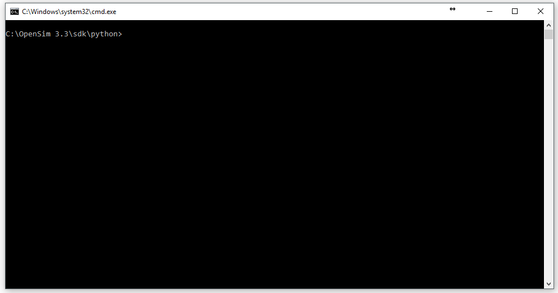
16
Run the OpenSim Setup File from Command Line
py -2.7 setup.py install
python setup.py install

Slide 17
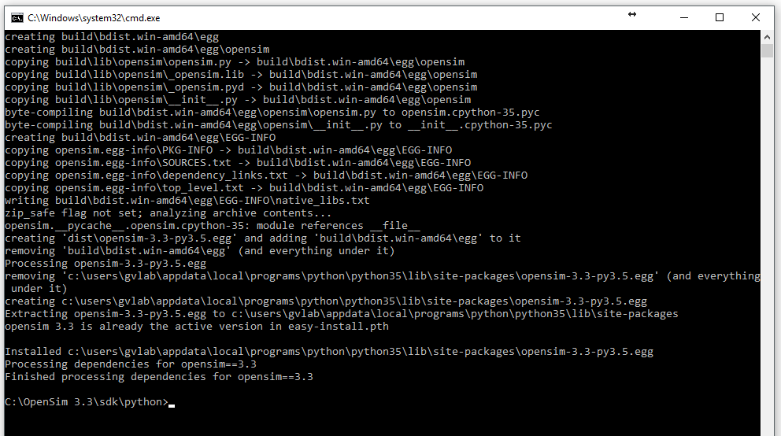
17
Run the OpenSim Setup File from Command Line
Do you have the same message that appears ?

Slide 18
18
Insert Python 2.7 scripts into the System Path
Control Panel -> System -> Advanced system settings -> Environment variables
Choose large icons

Slide 19
19
Insert Python 2.7 scripts into the System Path
Control Panel -> System -> Advanced system settings -> Environment variables

Slide 20
20
Insert Python 2.7 scripts into the System Path
Control Panel -> System -> Advanced system settings -> Environment variables

Slide 21
21
Insert Python 2.7 scripts into the System Path
Control Panel -> System -> Advanced system settings -> Environment variables

Slide 22
22
Insert Python 2.7 scripts into the System Path
Control Panel -> System -> Advanced system settings -> Environment variables

Slide 23
23
Insert Python 2.7 scripts into the System Path
Control Panel -> System -> Advanced system settings -> Environment variables
C:\Python27\Scripts

Slide 24
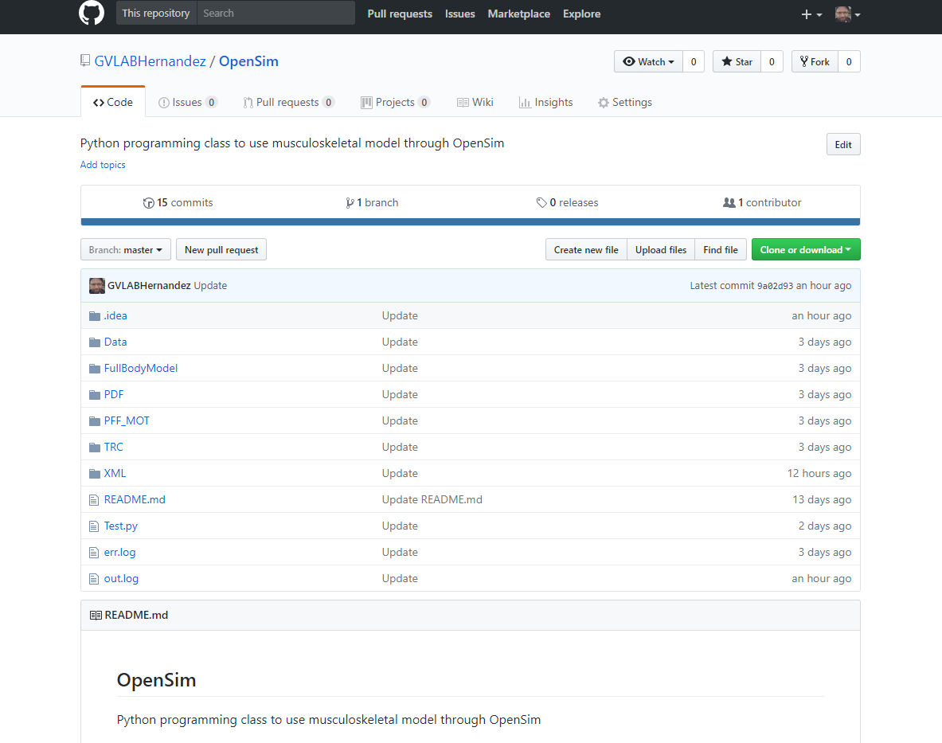
24
Download the GitHub repository
GitHub repository:
https://github.com/GVLABHernandez/OpenSim

Slide 25
25
Download the GitHub repository
Decompress the .zip file on your desktop

Slide 26
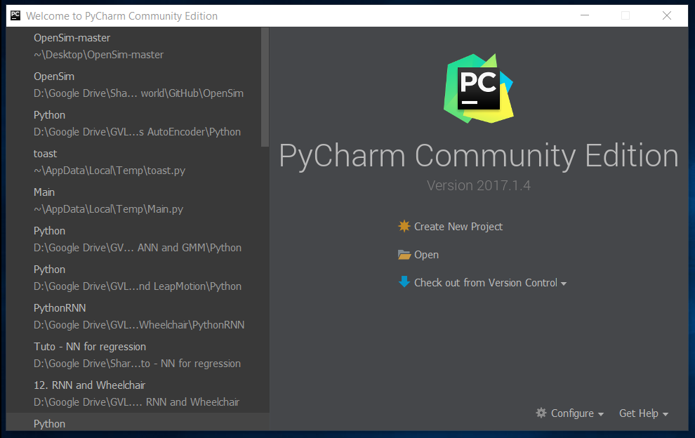
26
Test
Open PyCharm and click on Open

Slide 27
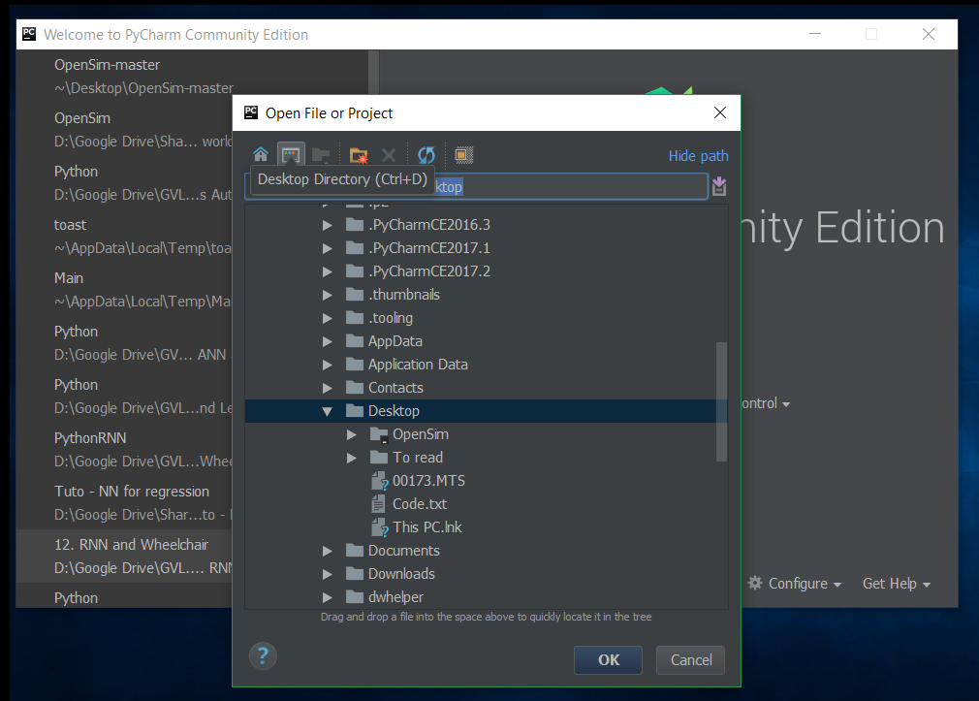
27
Test
Click on this icon to have access to your desktop

Slide 28
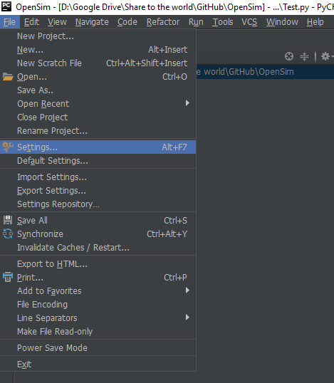
28
Test
Check the Python interpreter for this project

Slide 29
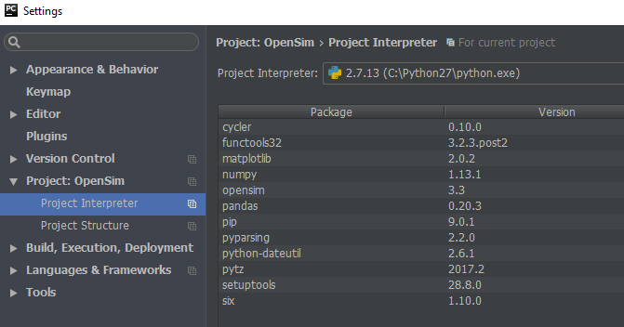
29
Test
Check the Python interpreter for this project

Slide 30
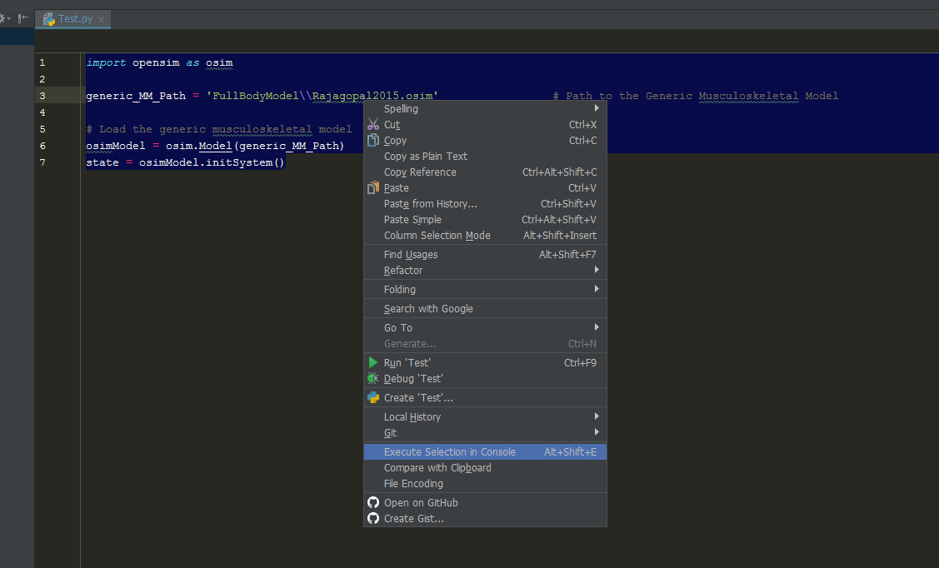
30
Test
Select all the code. Then, right-click on it and left click on Execute Selection in Console

Slide 31
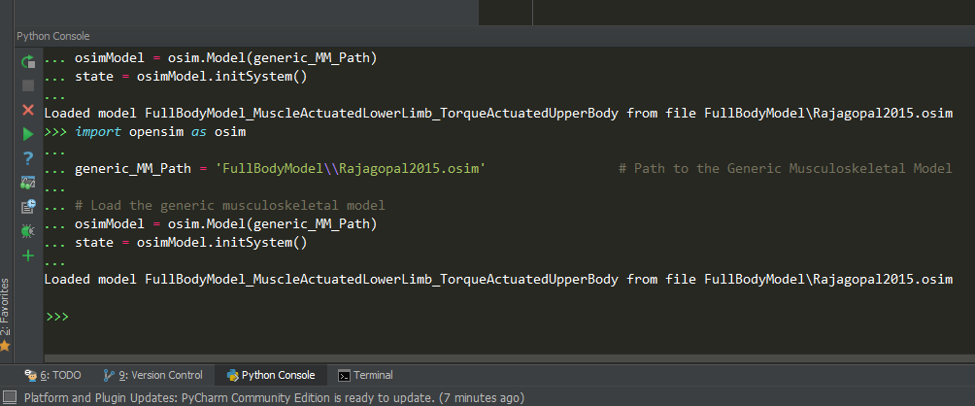
31
Test
Select all the code. Then, right-click on it and left click on Execute Selection in Console

Slide 32
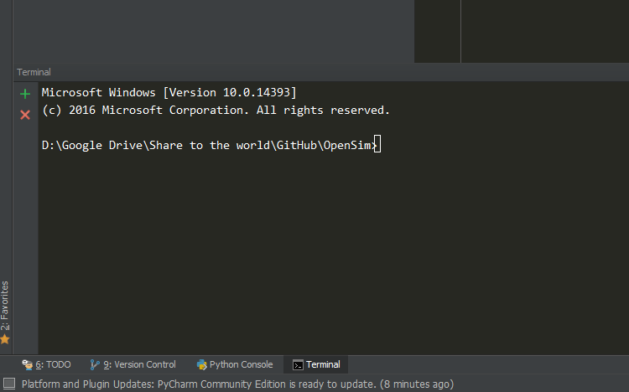
32
Install the python libraries needed
Python package:
Numpy, matpoltlib, pandas,
pip install numpy
pip install matplotlib
pip install pandas

Slide 33

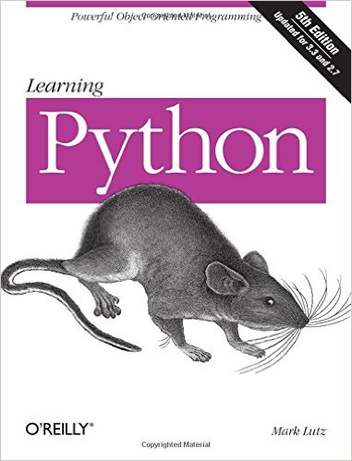
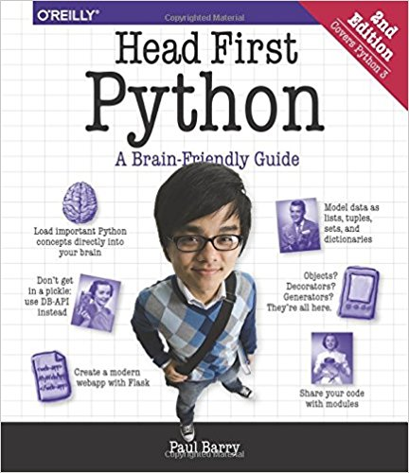
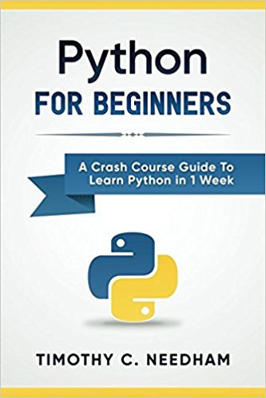
33
Next week
No programming yet.
Discover the friendly OpenSim interface
Learn more about Python:
- https://www.youtube.com/user/sentdex (Youtube - SENTDEX)
Learning Python, 5th Edition
Python: For Beginners: A Crash Course Guide To Learn Python in 1 Week
Head First Python: A Brain-Friendly Guide

